Slide 1
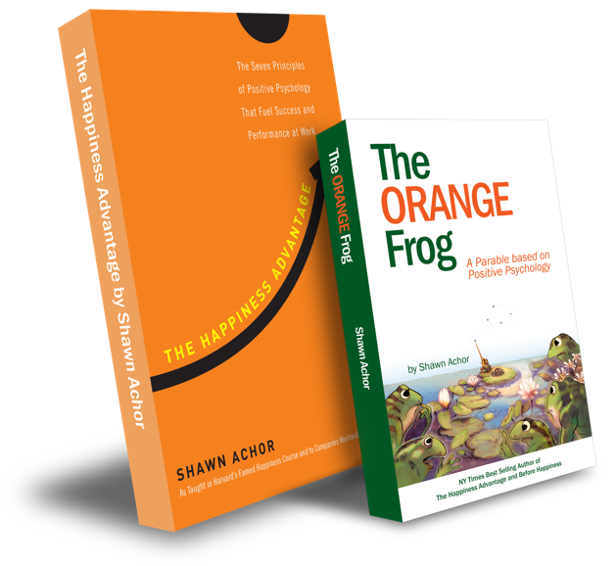
The Doubler

Slide 2
Week Three
The Doubler

Slide 3
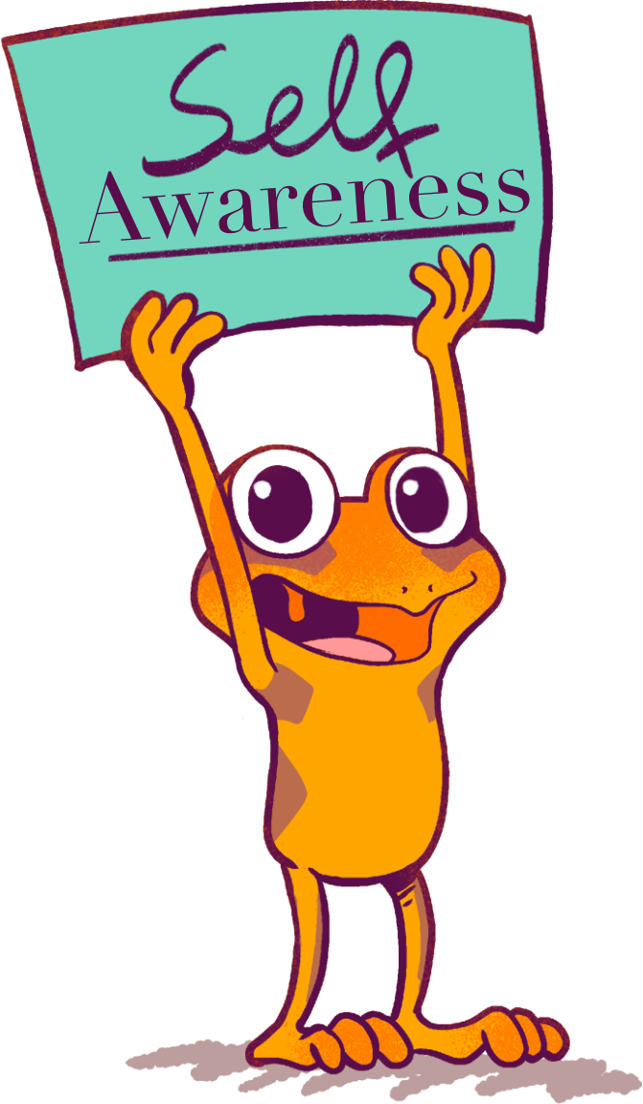
The Orange Frog
Learning Objective:
I can write about positive experiences to build self-awareness.
I will discuss the importance of knowing what it takes to create happiness for myself.
Notes:
Standard:
Essential Concept and/or Skill: Communicate and work productively with others emphasizing collaboration and cultural awareness to produce quality work.
Interact positively as a team member.
Cooperate with others in a group setting.
Generate ideas with group members.
Are active listeners.
Read and understand information in a variety of forms.
Express ideas.
Skill:
Active listening, express ideas

Slide 4
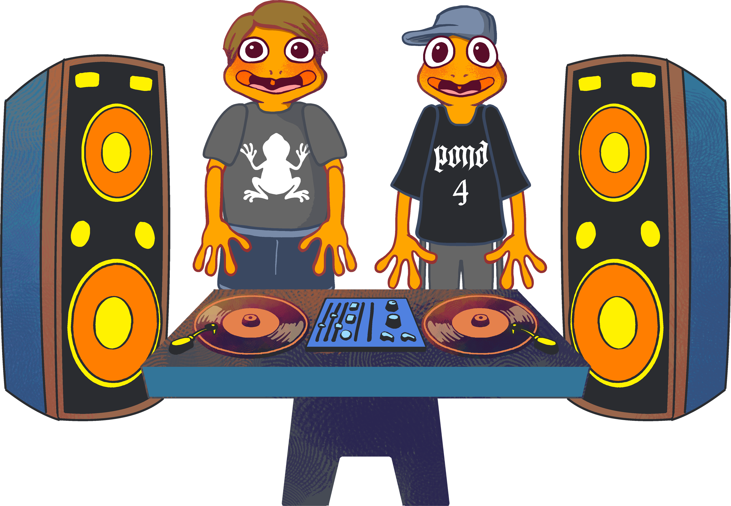
Skillz
Communitcate Clearly
Use information creatively.
Opening Questions
What does it mean to be Self Aware? OR
What are the benefits of being Self Aware?

Slide 5
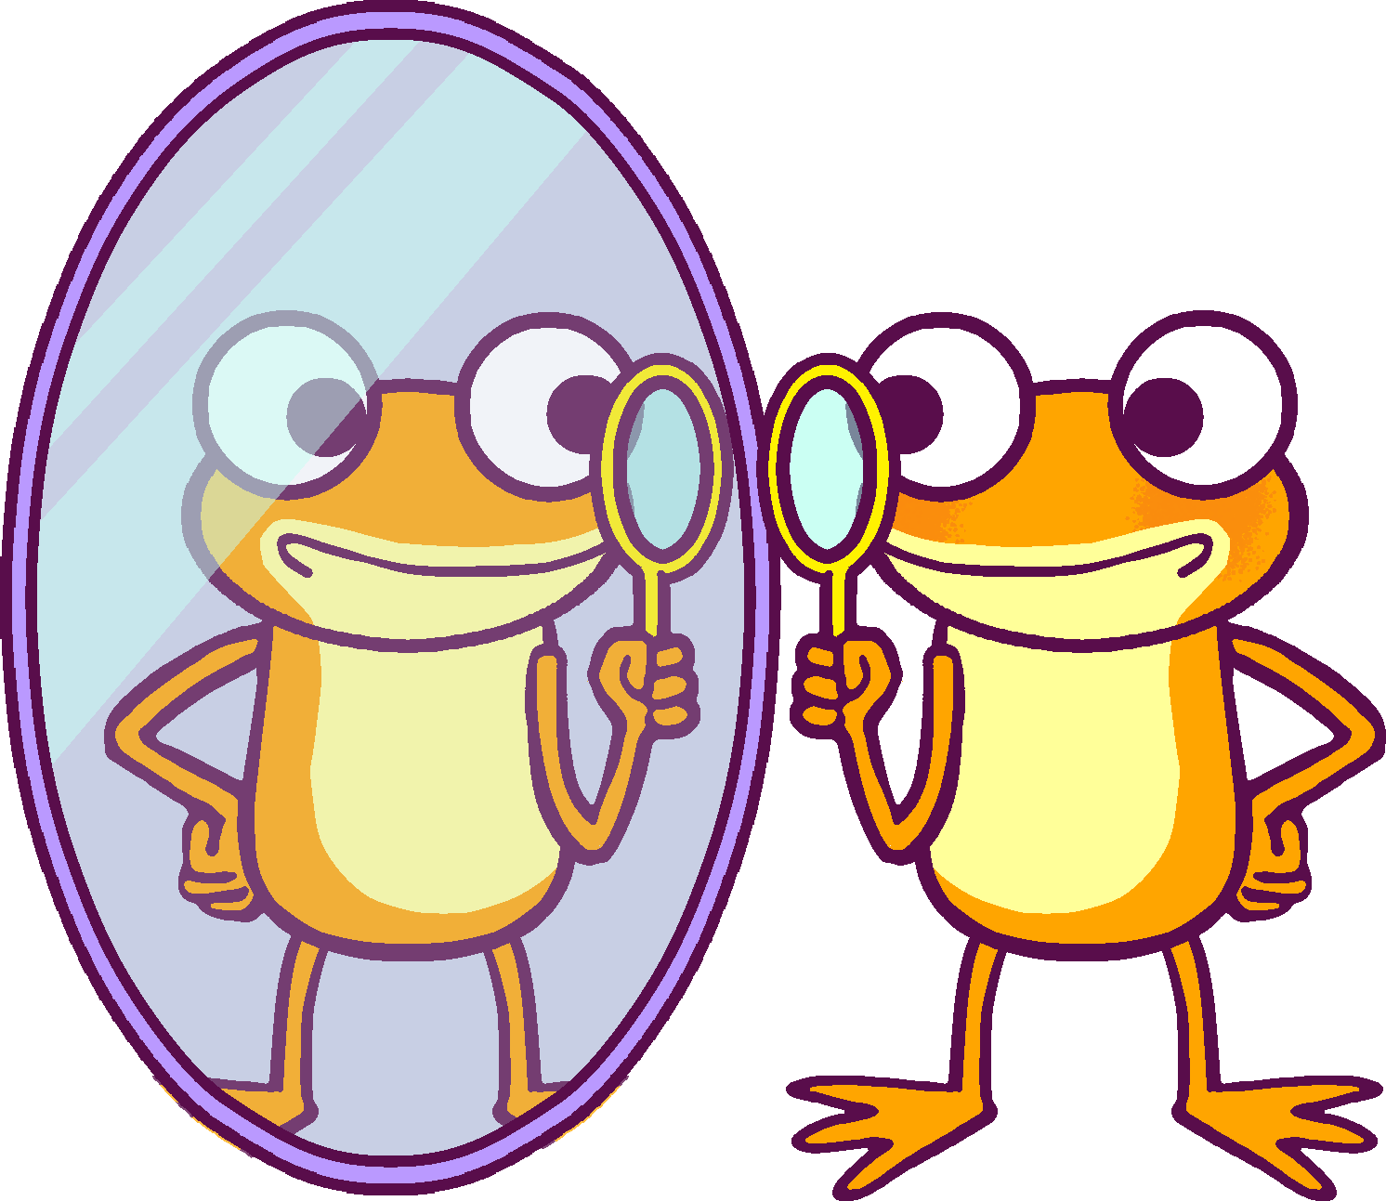
Thoughts
To know yourself means to know what makes you “tick”.
What makes you happy?
What makes you sad?
What makes you laugh?
When we know ourselves well, we can decide what to do when different things happen.
If something makes us irritable or upset, we can cheer ourselves up.
If something makes us angry or frustrated, we can calm ourselves down.

Slide 6
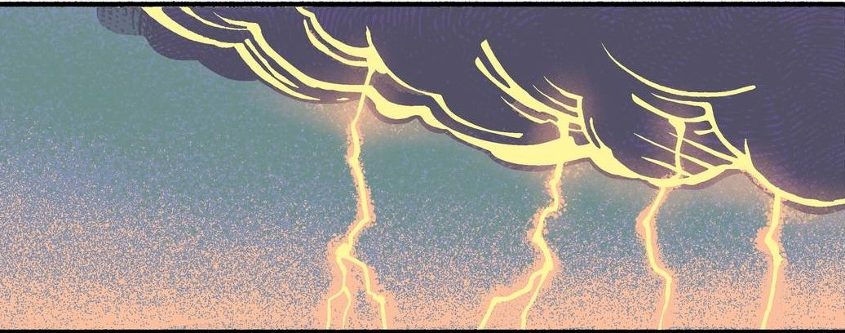
Action
Today, we are going to do an interactive self-assessment to determine the level of self-awareness we hold.
Notes:
Use DISC Assessment https://www.123test.com/disc-personality-test/ Or create something like it!

Slide 7
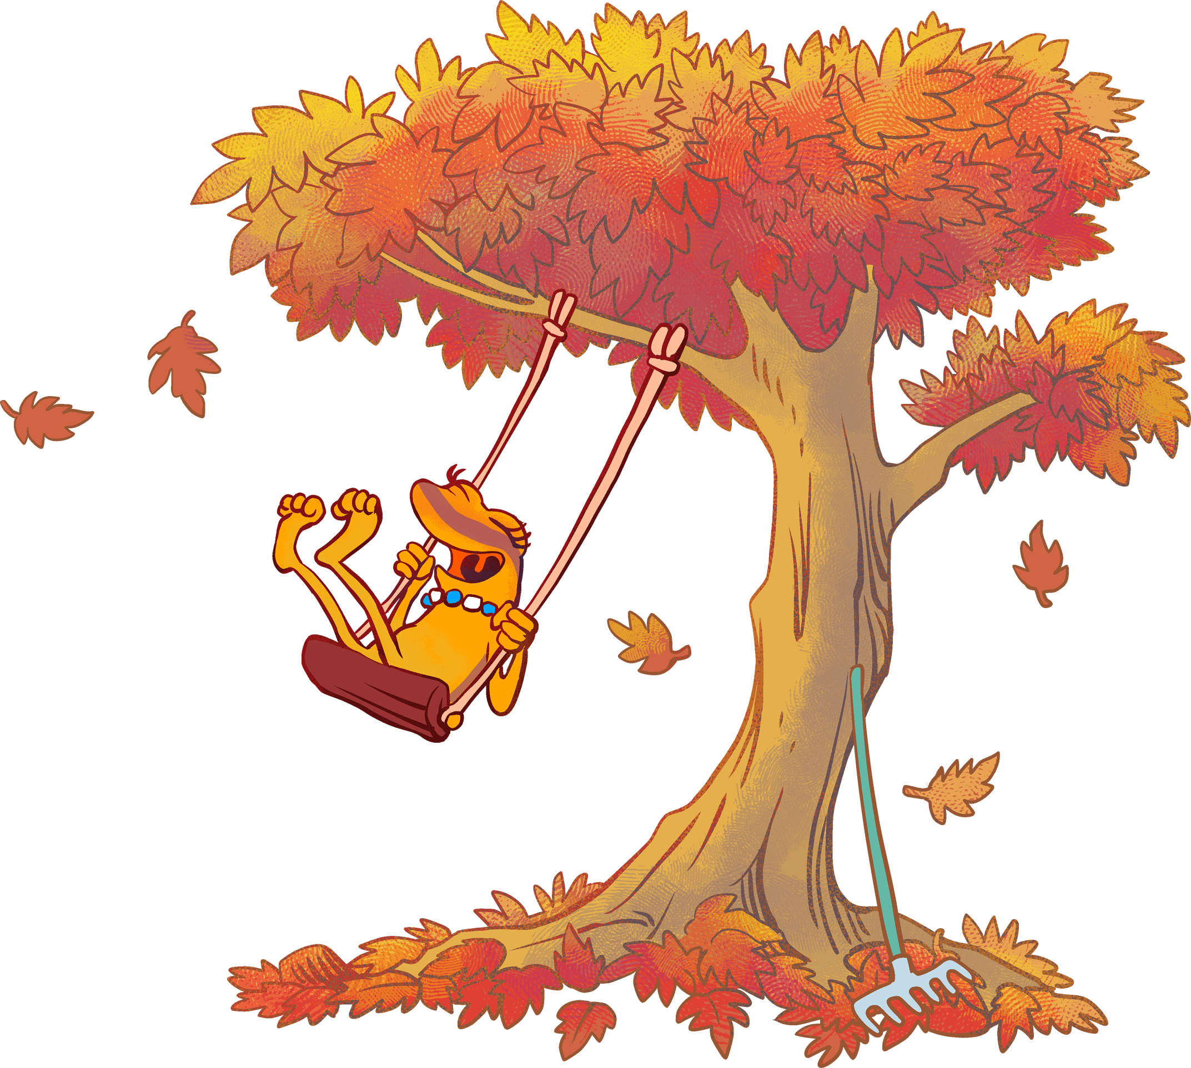
Doubler Journal
Don’t forget, your “doubler” experience should have three things details to describe it and be within the last 24 hours.
Make sure you make an entry into your journal for today!

